Slide 1
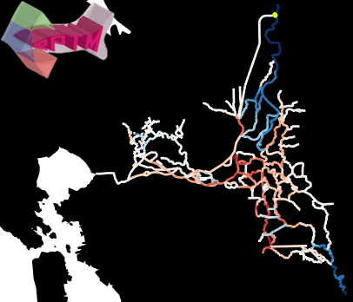







The Enhanced Particle Tracking Model Version 2.0: Calibration and validation
Vamsi Krishna Sridharan, Doug Jackson, Russ Perry, Adam Pope, Andrew Hein, Noble Hendrix, Eric Danner, Steve Lindley
December 1, 2021
Notes:
Good afternoon, everyone. Let’s talk calibration and validation of the ePTM! I want to emphasize that this model always has been a collaborative effort.
We are very thankful to DWR who have provided us the underlying hydrodynamics engine and the foundations upon which ePTM is built.
And a word about our funders: I don’t think we could have asked for more wonderful people to work with, and I hope that we can convince the Bureau of Reclamation and California Department of Fish and Wildlife that they have got much more than what they paid for.
If you’ve not already been distracted by the pretty neon dots swimming around in the rivers of strobing blues and reds, that is the culmination of a calibrated and validated ePTM v2. Oceanward flows are blue and landward flows are red, and little green virtual fish are migrating through in the first week of February in 2012.

Slide 2
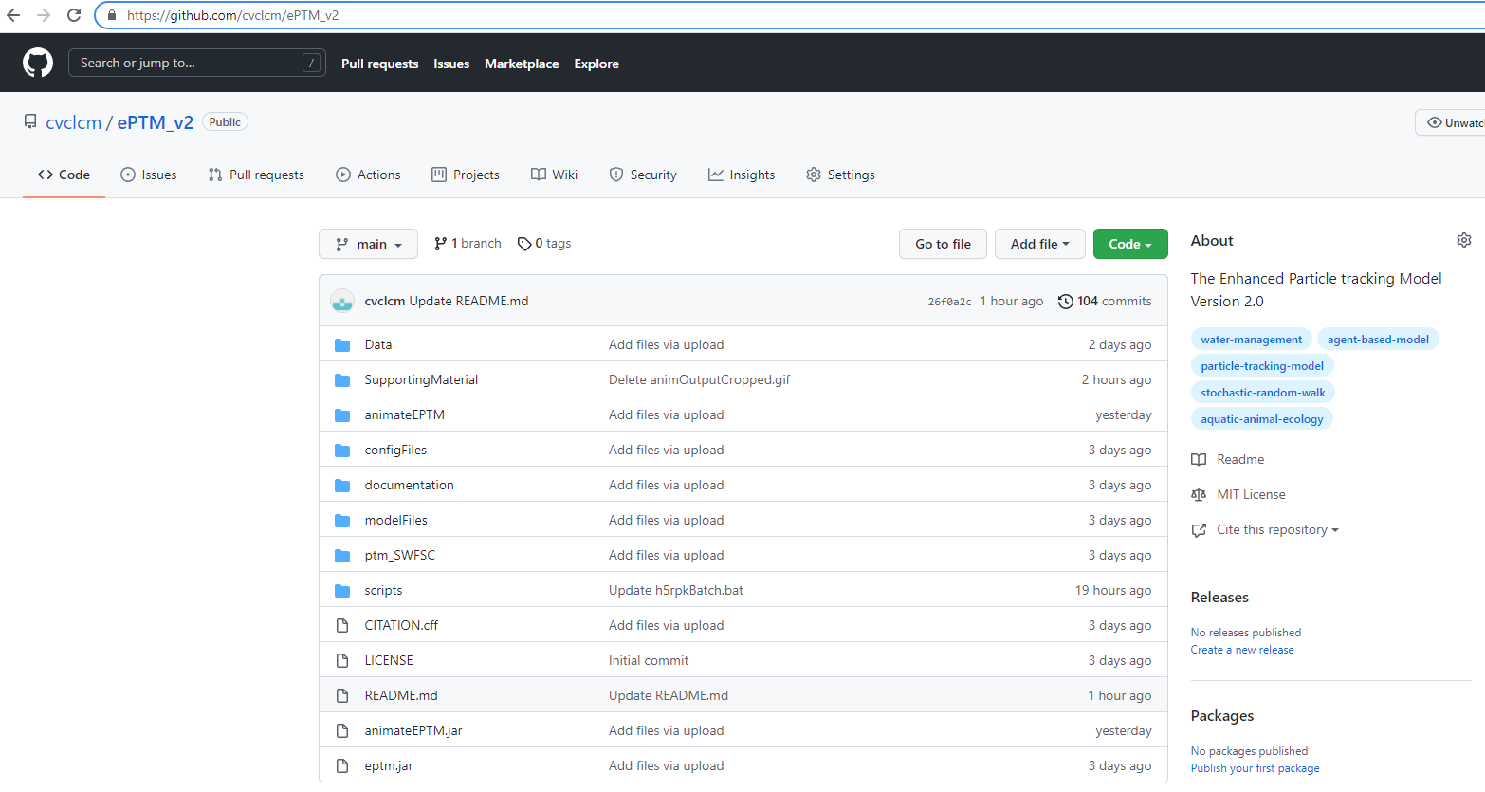
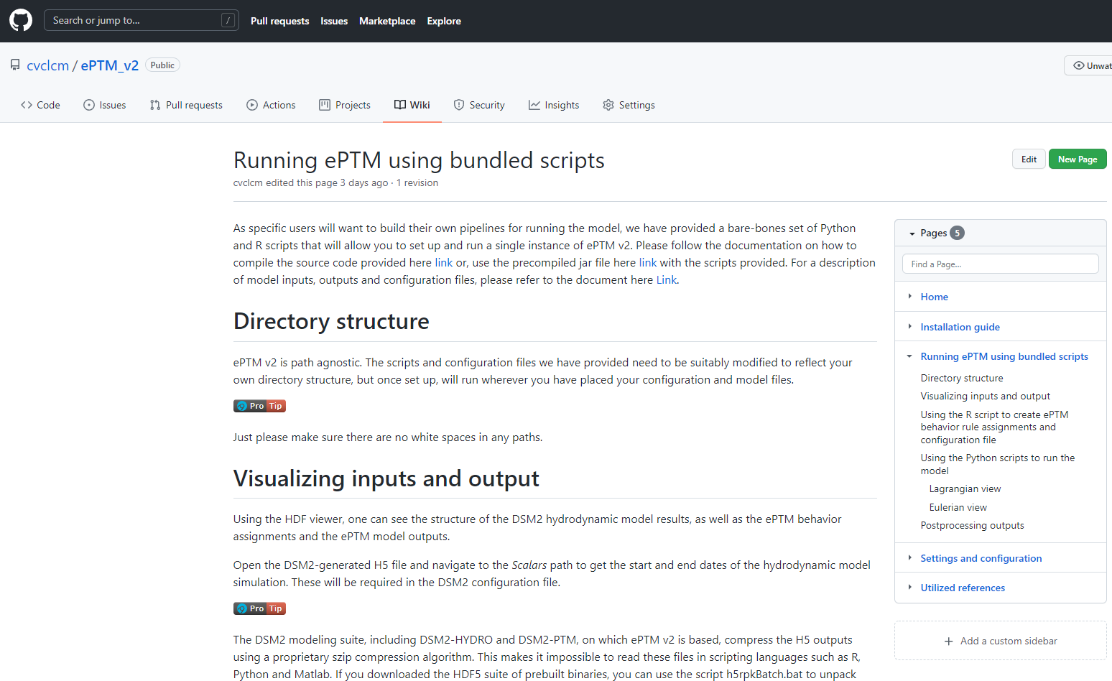
Into the beast’s lair (github.com/cvclcm/ePTM_v2)…
Notes:
Before we get into it, here’s an exciting update. We have a GitHub repo for the model. We’ve also included some extra goodies there. All you need to do is go to github.com/cvclcm/ePTM_v2. In the repo, you will also find detailed descriptions of the model structure, the calibration and validation process, and all the data that was used in various aspects of model development.
There is a detailed model Wiki, wherein you’ll find an installation guide, and to set up and run the model. We’re also working on making the model interface more user-friendly and accessible, and will have an interactive web-based tool like our WRLCM website shortly.
Please do note that the Github repo hosts the ePTM model and bare bones scripts to run it. Although the version of the calibrated model that’s there is the same one we’re using for DCP analysis, the configuration and pre- and post-processing workflow and scripts we’re using for the DCP analysis in the WRLCM are not hosted there, so don’t expect to be able to download and plug and play and get the exact same answers we get.
We’ll periodically update latest news about the model on the readme document.

Slide 3
What we’ll do today
Background
Model description
Model parameters
Calibration
Process
results
Validation
Datasets
Results
Notes:
All right. ’ll briefly describe the model to motivate the calibration and validation part of the talk.
Then we’ll get to the model calibration and validation. I want to emphasize that this model has been validated with out-of-sample data.
If you want more details on the model, you can find links to the ePTM v2 study plan hosted on the WRLCM site, as well as a video of the talk I gave at the Bay Delta Science Conference earlier this year in the supporting material section of the Github repo.

Slide 4
Background
Notes:
Ok, let’s take a super high-level look at the model.

Slide 5
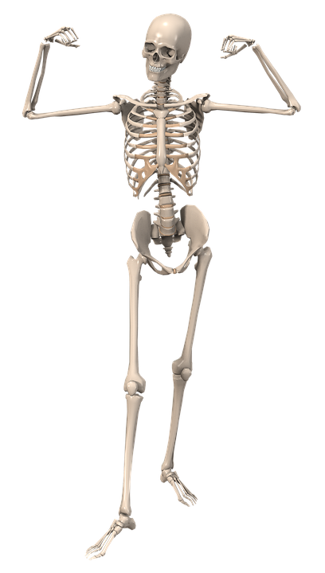
Model description
Notes:
Pared down to its bones …

Slide 6
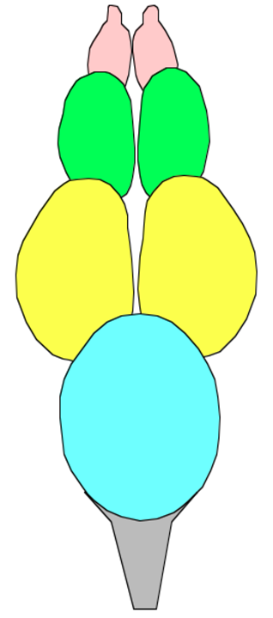
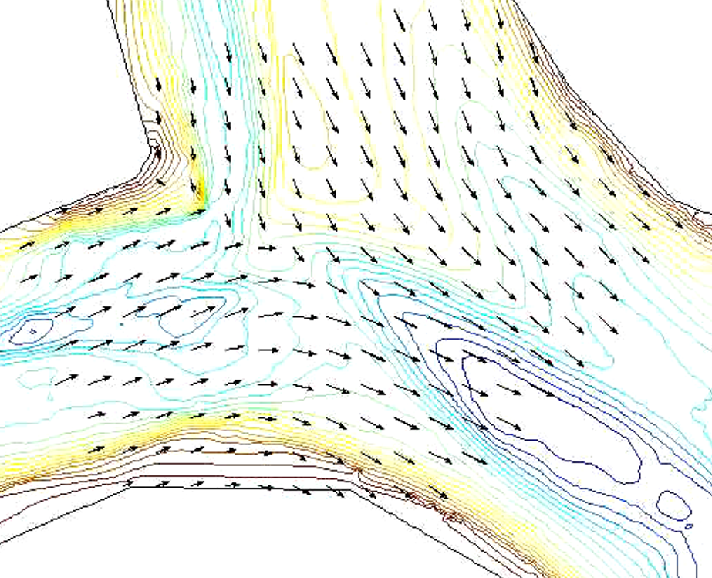
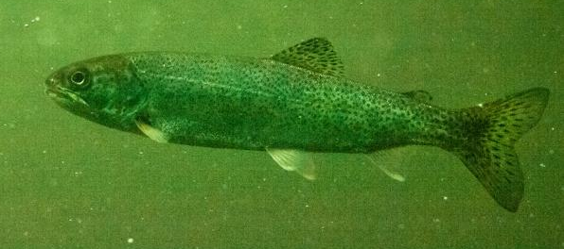
Model description
Notes:
The ePTM is just a model that layers behavioral decisions, that could be made in a fish’s brain shown here, on movement in addition to movement according to the local flow, like in the flow field shown here, to move fish through the system. In the ePTM, by behavior, we mean 15-minute averaged movements, and not instant-to-instant behaviors. Of course, even these averaged “behaviors” are very complex, and their combination with time-averaged hydrodynamics result in random movements. Let’s look at this interplay in more detail.

Slide 7




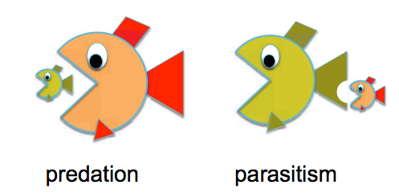

Model description
Notes:
The behavior aspect of the model has five components: movement, holding, orientation, predation and routing. If you would like to know more about the intricacies of these components, the WRLCM website hosts the ePTM study plan, and the GitHub repo hosts a video of the talk I gave at the Bay Delta Science Conference earlier this year. Of these, routing is purely hydrodynamic and follows the critical streakline approach. We don’t have any calibration parameters associated with routing at the moment.

Slide 8
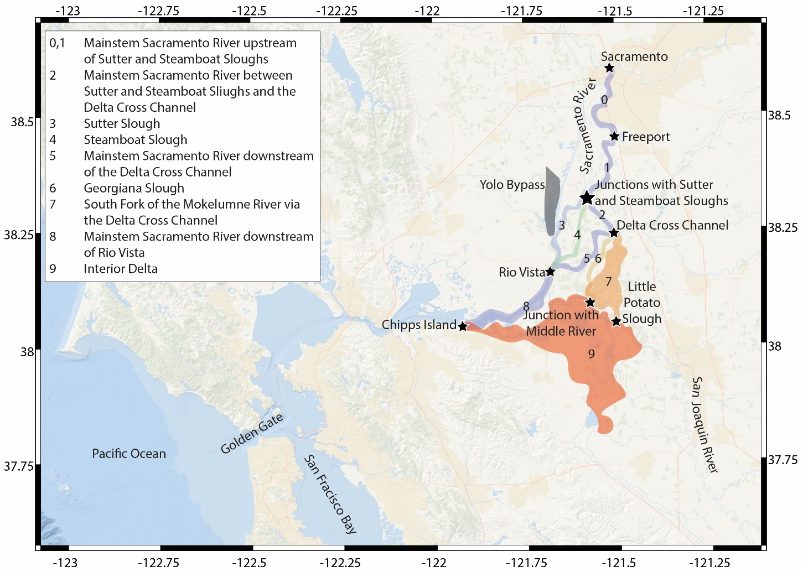
Model parameters
S.No. | Parameter | Behavior class
1 | Mean migration rate | Swimming
2 | Standard deviation of migration rate
3 | Half-saturation point of logistic function | Orientation
4 | Slope of logistic function
5 | Probability of memory persistence
6 | Rheotaxis factor
7 | Flood phase holding threshold velocity | Holding
8 | Probability of daytime swimming
9 | Holding probability
10 | Mean free path length between encounters | Survival
11 | Random closing speed
Notes:
ePTM is a spatially explicit model, which means that, technically, each point within the model domain can have a different behavior parameter combination associated with it. Ut we’ve made the following design choice.
We have used VEMCO tagged late Fall-run Chinook released between 2006 and 2010 and mark-recapture analysis done by Russ to calibrate the model. To be consistent with that analysis, and to keep things tractable, we have allowed behavior parameter values to be constant within each of the 9 reaches in Russ’ analysis. So, with 11 parameters in all, the model has a total of 99 tunable behavior parameters. Let’s see how we fit these.

Slide 9
Calibration
Notes:
Don’t worry if you aren’t all caught up with the model structure. There are lots of resources we have put out you can look at later, and an annotated version of this slide deck will also go up on the GitHub repo and the WRLCM website. Now, I’ll walk through the calibration process and share results. For model calibration, we used VEMCO tagged late Fall-run Chinook released in 8 batches between 2006 and 2010, and put through the ringer by Russ Perry, Adam Pope and others at USGS. This dataset had a total of 1,583 fish, and was the most optimal to use in terms of telemetry station coverage and number of fish. Newer datasets from the JSATS program are available, but we held these for out-of-sample validation. To fit the migration parameters, we used the travel time distributions estimated using first arrival times at telemetry station pairs, and to fit survival parameters, we used Russ Perry and Adam Pope’s CJS analysis, which they reported in their copiously cited 2018 paper. I’ll walk through the calibration process next.

Slide 10
Calibration steps
Elementary effects analysis
Performed on coarse grid ePTM
Separation of survival and migration parameters is possible
Coarse search for optimal migration parameters
Select design points
Multiobjective optimization
Refined search for optimal migration parameters
Zoom into neighborhoods of top performing parameter sets
Repeat multiobjective optimization
Search for optimal survival parameters
Hold migration parameters at optimal values
Grid search optimization
Notes:
We applied a four-stage calibration process as shown here. The pictures in the boxes represent intermediate visualizations we made during the process. We fit model parameters to each mark-recapture reach. As mark-recapture analysis was used for each reach, we could fit the eleven model parameters for each reach independently of the other reaches. Also, because of this, we could combine all 8 releases within each reach to set a common set of parameter values across releases. There is a long-winded mathematical proof as to why we can do this, but I won’t get into that here.

Slide 11
Calibration steps
Elementary effects analysis
Performed on coarse grid ePTM
Separation of survival and migration parameters is possible
Coarse search for optimal migration parameters
Select design points
Multiobjective optimization
Refined search for optimal migration parameters
Zoom into neighborhoods of top performing parameter sets
Repeat multiobjective optimization
Search for optimal survival parameters
Hold migration parameters at optimal values
Grid search optimization
Notes:
First, we deduced that the movement parameters could be fit independently of the survival parameters using an elementary effects analysis on a version of the ePTM model with a greatly simplified model domain.
Next we switched to the full ePTM model, and ran simulations in which we released 10 virtual fish for each real fish in all subsequent steps.

Slide 12
Calibration steps
Elementary effects analysis
Performed on coarse grid ePTM
Separation of survival and migration parameters is possible
Coarse search for optimal migration parameters
Select design points
Multiobjective optimization
Refined search for optimal migration parameters
Zoom into neighborhoods of top performing parameter sets
Repeat multiobjective optimization
Search for optimal survival parameters
Hold migration parameters at optimal values
Grid search optimization
Notes:
Second, we performed a coarse grid search on a 360,000 movement parameter values to narrow in on the best local optima defined within a multiobjective optimization framework. That’s 5,000 design points for each reach for each release. In this multiobjective optimization problem, we considered three measures of goodness-of-fit: the likelihood of modeled travel times matching observed travel times, the Earthmover’s distance, which is an information theoretic function that quantifies how far one distribution is from the other, and the Jaccard index, which graphically measures how much two distributions overlap. We then summed these goodness-of-fit measures over all releases for each reach to get the overall goodness-of-fit for a design point. We then selected the top 10% points on the Pareto front, that is, if you are at one of these points, you can do no better along any one of the goodness-of-fit measures unless you sacrifice performance along another metric. What we are essentially doing here is a grid search. So, to ensure that the results are robust, we wanted to have several independent measures of goodness-of-fit to compare across. These points were the local optima we selected to proceed with.

Slide 13
Calibration steps
Elementary effects analysis
Performed on coarse grid ePTM
Separation of survival and migration parameters is possible
Coarse search for optimal migration parameters
Select design points
Multiobjective optimization
Refined search for optimal migration parameters
Zoom into neighborhoods of top performing parameter sets
Repeat multiobjective optimization
Search for optimal survival parameters
Hold migration parameters at optimal values
Grid search optimization
Notes:
Third, we zoomed into the parameter space in to 10% neighborhoods of the best local optima to perform a fine grid search using the multiobjective optimization framework to identify the global optimum movement parameter values. Exactly as before, but only now the 5,000 design points were spread around more tightly around the local optima from the first round. We expect that the top performing nondominated parameter set after this round will be optimal.

Slide 14
Calibration steps
Elementary effects analysis
Performed on coarse grid ePTM
Separation of survival and migration parameters is possible
Coarse search for optimal migration parameters
Select design points
Multiobjective optimization
Refined search for optimal migration parameters
Zoom into neighborhoods of top performing parameter sets
Repeat multiobjective optimization
Search for optimal survival parameters
Hold migration parameters at optimal values
Grid search optimization
Notes:
Fourth, we held the movement parameters at their optimum values and performed a grid search with 625 points over the two survival parameters to find the optimum values these parameters. The goodness-of-fit measure used here was simply the absolute difference in modeled and CJS survivals. The goodness-of-fit surface for these two parameters is quite well behaved, and a grid search is guaranteed to produce an optimum close to the global optimum. Ok, let’s see how we did.

Slide 15
Calibration performance: travel time distribution
Notes:
Since travel time distributions in each reach are the data that the model is being fit to, we’d like our model to get those more or less right.

Slide 16
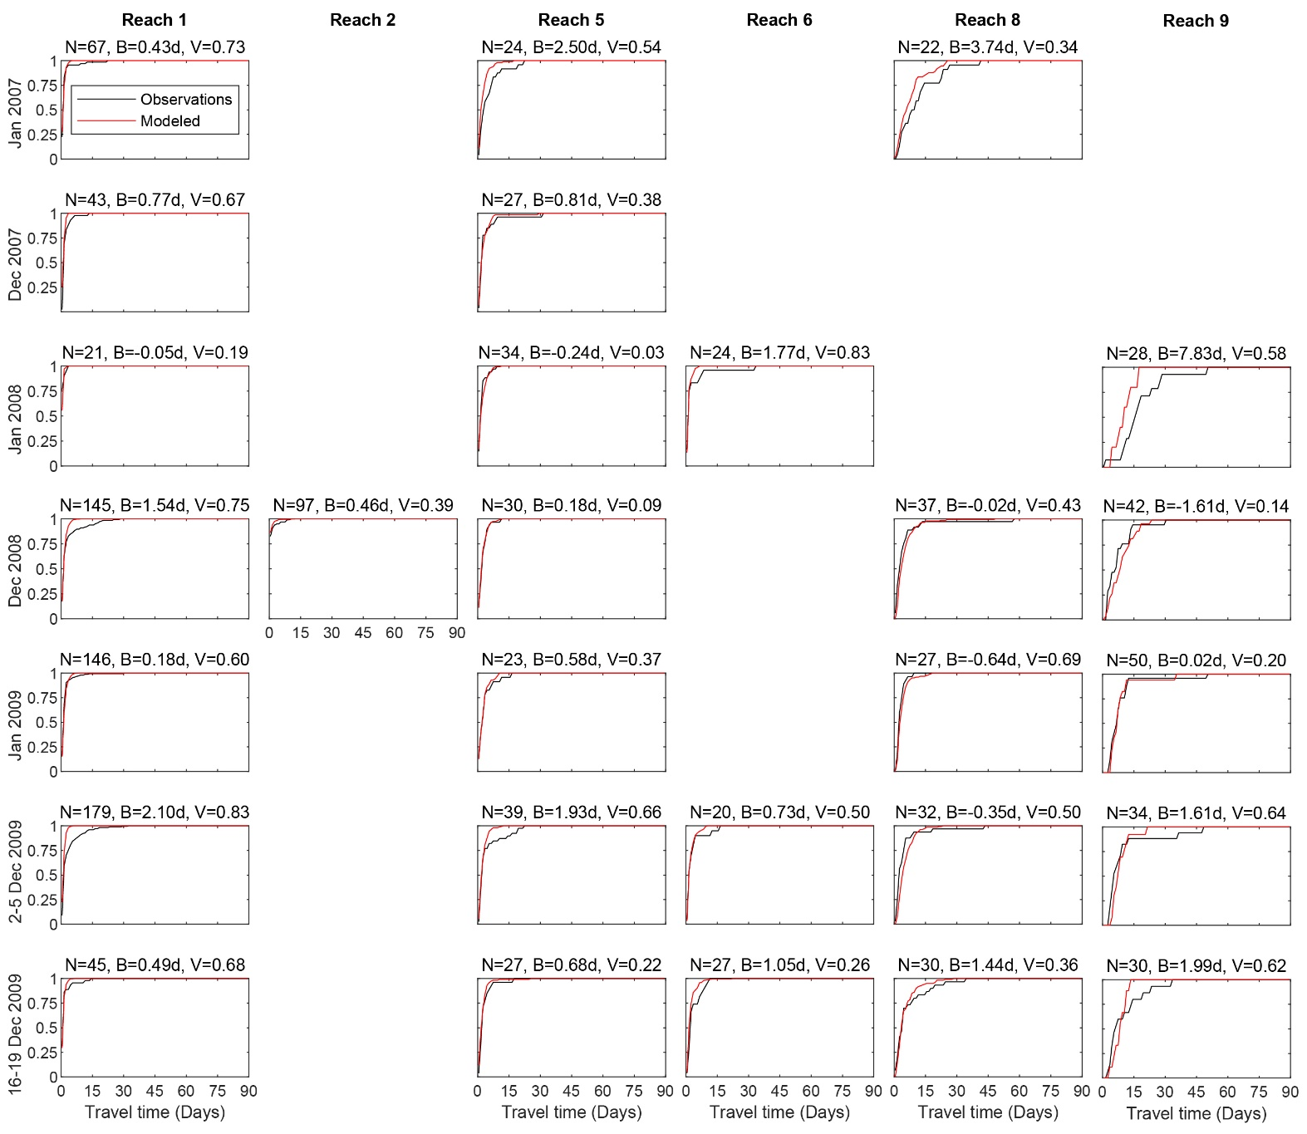
Calibration performance: travel time distribution
Notes:
In the next set of plots, I’ll be showing a matrix of plots like this. These compare the cumulative distribution of differences in first arrival times at the end and start of each reach across each release: black for observations and red for the model. I’ll only be showing those reach-release combinations in which there were at least 20 fish. The numbers on top of each plot are: N is the number of fish, B is the bias between observed and modeled travel times, and V indicates by how much the standard deviation in predicted travel times vary relative to the standard deviation in observed travel times and is a measure of how different the two distributions are.

Slide 17
Calibration performance: travel time distribution
Notes:
Reaches are along the columns, and releases are along the rows here. First of all, we see that the model fits observed travel times really well. Rarely, expect when there are too few fish does the bias exceed two days. In travel durations that last one to three weeks, that’s pretty awesome. The V parameter is also quite small in almost all the cases, indicating that the distributions are shaped similarly. In some of the reversing reaches, the model does miss bi- and multi-modalities in the travel time distributions, but we feel this can be attributed to differences between individual fish.

Slide 18
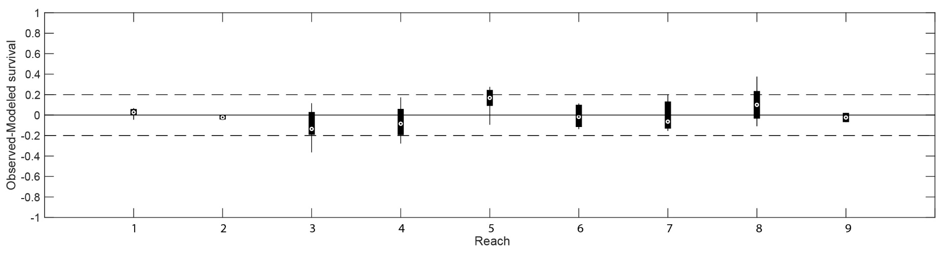
Calibration performance: survival
Notes:
Here, I’m showing boxplots of differences in estimated and observed survival in all the 8 releases for the top 20 set of nondominated parameter values. So, each box here is comprised of a distribution of observed to modeled survival differences between 20 runs of the model each with the top performing survival parameter estimates for each of the 8 releases. The zero line indicates the best possible model, that is no deviation from observed survival. The dashed lines indicate plus or minus 0.2 absolute difference. We see that the model is actually doing very well in predicting reach-by-reach survival, with predictions rarely deviating from observations by more than 0.2. This is really good news.

Slide 19
Validation
Notes:
Ok, so we looked at the model, and its calibration. For the validation, we decided to focus on the key issues that are of management interest. This is ultimately a decision support model, and we need to evaluate how well it fulfills this role. We also wanted it to be a truly out-of-sample validation exercise, so were somewhat limited by what data is available.

Slide 20
Validation process
Survival
Overall survival between Tower Bridge and Chipps Island
JSATS data from https://oceanview.pfeg.noaa.gov/CalFishTrack/
1,335 Fall- and Winter-run Chinook in 11 releases between 2012 and 2017
Mark-recapture analysis derived survivals reported in CalFishTrack
Routing
Fraction of fish routing through Sutter and Steamboat Sloughs during ebb and flood tides
Fraction of fish routing through Goergiana Slough during ebb and flood tides
278 Winter-run Chinook in 2014 and 2015
Notes:
So, we’re going to be looking at two aspects of the model’s performance. predicting overall survival to Chipps Island, and routing probabilities through key migratory routes. Even though we calibrated with late Fall Chinook, we performed the out-of-sample survival validation with fall- and winter-run fish because we have strong evidence that functionally, these runs aren’t all that different from each other.
For survival validation, we selected all the JSATS tagged releases that had fish detections within the Delta, with at least 100 fish released between 2012 and 2017, and this gave us 1,335 fish spread across 11 release groups to look at. The reason we only went up to 2017 is because DWR has release historical configurations for DSM2 only until 2017. The “data” were CJS survival estimates from Tower Bridge to Chipps Island. To compare for each release, we initialized the model with 10 replicate virtual fish released at Tower Bridge at the same time as each real fish was detected there. We then recorded all the fish that passed Chipps Island, and estimated modeled survival as the fraction passing Chipps.

Slide 21
Validation process
Survival
Overall survival between Tower Bridge and Chipps Island
JSATS data from https://oceanview.pfeg.noaa.gov/CalFishTrack/
1,335 Fall- and Winter-run Chinook in 11 releases between 2012 and 2017
Mark-recapture analysis derived survivals reported in CalFishTrack
Routing
Fraction of fish routing through Sutter and Steamboat Sloughs during ebb and flood tides
Fraction of fish routing through Goergiana Slough during ebb and flood tides
278 Winter-run Chinook in 2014 and 2015
Notes:
For routing validation, we wanted to look at what fraction of fish go through Sutter and Steamboat Sloughs, and what fraction enter Georgiana Slough. These are key migration routes that influence overall survival. We also wanted to look at the key critically endangered species here, the Winter-run Chinook. So, we decided to look for all the JSATS releases which had fish detected at stations along these routes, and found that only the 2014 and 2015 releases satisfied the criteria. This gave us 278 fish to look at. In this analysis, we stratified the data into detections at stations in all these different routes during different tide phases. In the ePTM, we released 100 replicate virtual fish for each real fish at Tower Bridge at the same time the real fish was detected there, and tracked the fraction that went through each route. In 2014, a floating fish guidance study was done, so we installed a particle filter at the entry to Georgiana Slough in the model operating at an overall efficiency of 77%. This is the same value that was reported in DWR’s 2016 report on the study.

Slide 22
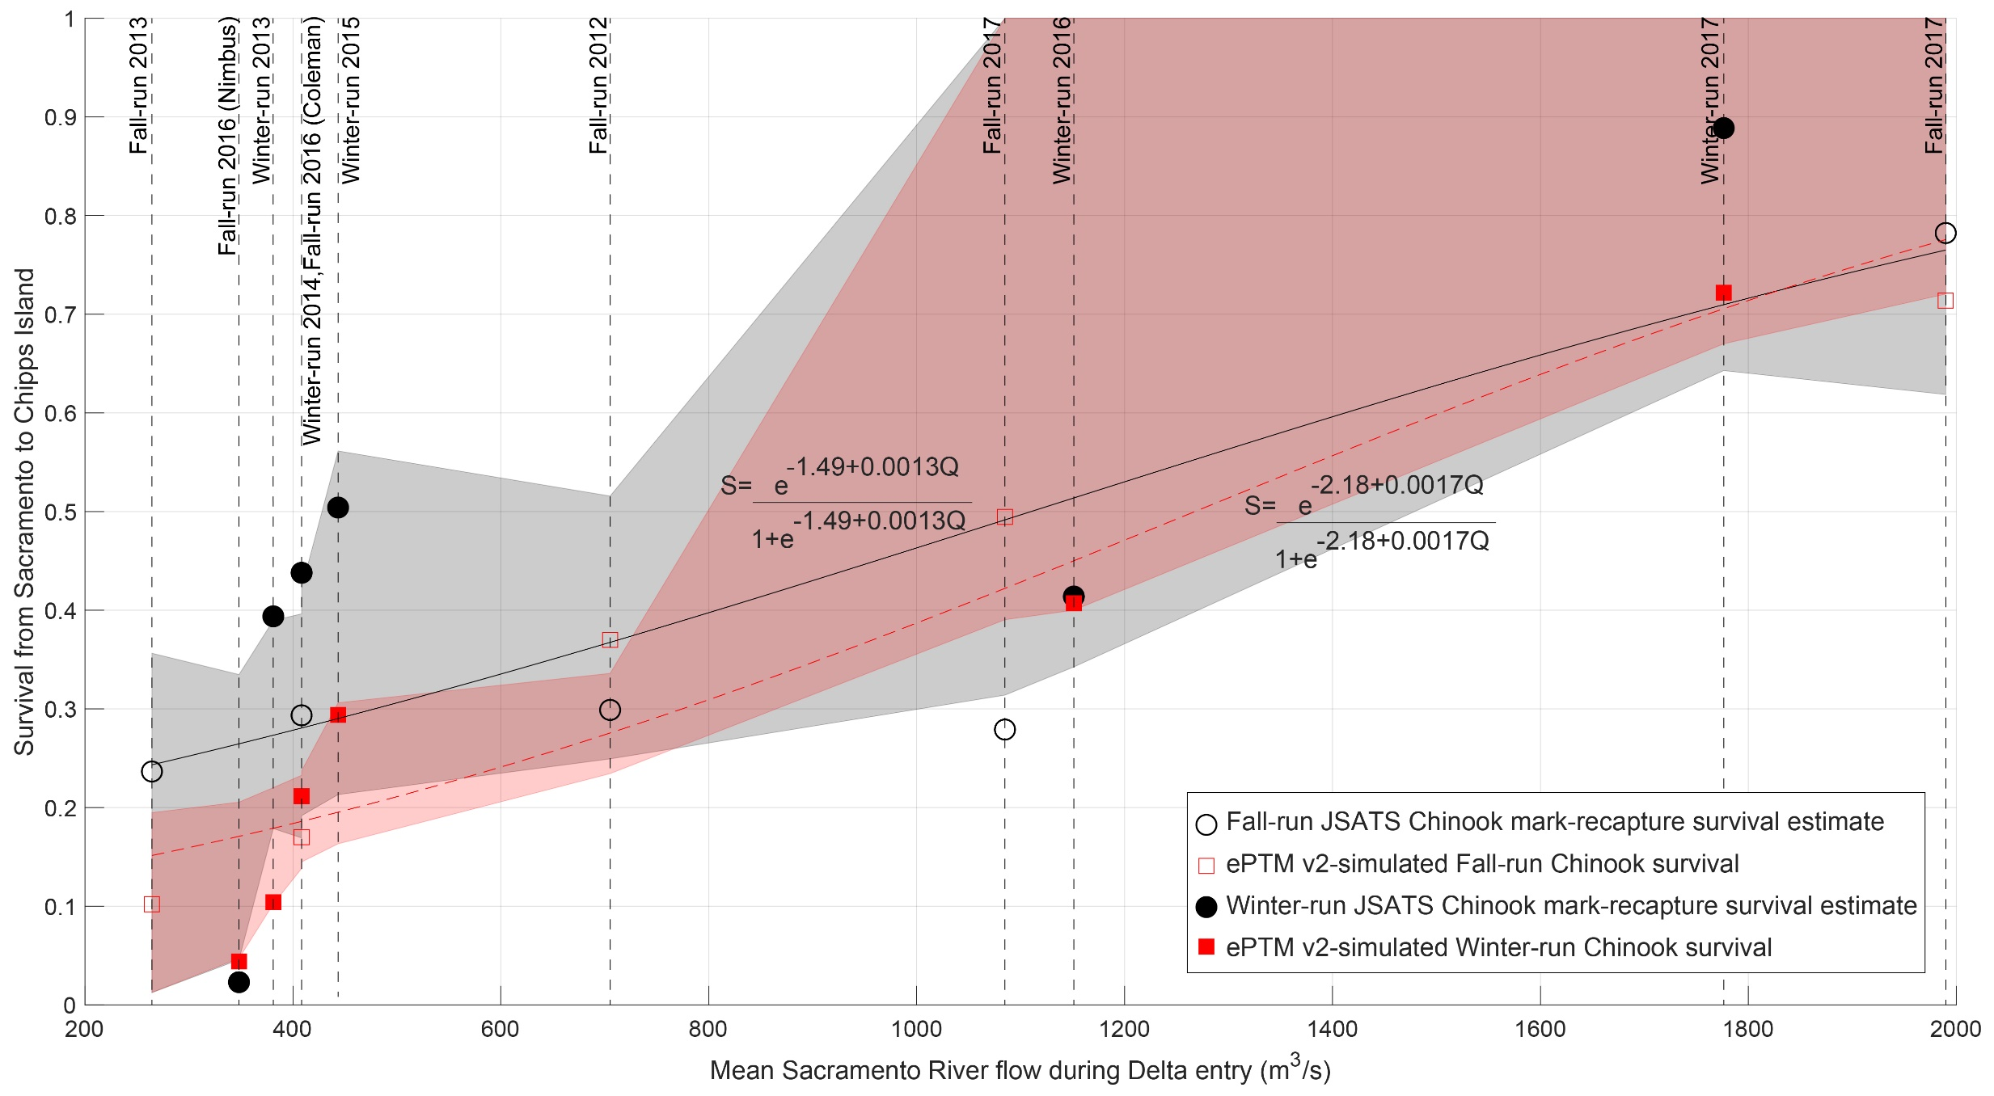
Validation results: Survival
Notes:
Here, I am showing the observed and predicted survivals for the 11 releases, but plotted as a function of flow. This way, we can not only evaluate how the model is doing compared to the data, but whether it is also able to reproduce the key flow versus survival relationship in the Delta.
Red squares represent model predictions and black circles represent CJS estimates fit to the data. Open symbols indicate fall run and closed symbols indicate winter run releases. For each release, flows were estimated as the mean flow in the Sacramento River at Freeport over the duration between the first fish passage and the last fish passage through this location. The dashed red line and black solid line represent logistic curves we fit to the model results and the CJS-reported survivals. Red and grey shaded areas represent 95% confidence intervals generated by applying the same logistic fit to 10,000 replicates of these points chosen at random with replacement.

Slide 23
Validation results: Survival
Notes:
First of all, we see that modeled survival is typically off from observed survival by no more than 0.2, which is remarkable considering that this is the survival through the entire Delta, and not per kilometer or per reach! The overlap of these confidence intervals indicates model precision up to data precision.
Secondly, over a wide range of flows going from 7,000 to 70,000 cfs, the flow-survival relationship predicted by the model is pretty darn close to what the data is telling us. And remember, these are actually out-of-sample data!

Slide 24
Validation results: Survival
Notes:
Oh… and one more thing. The Fremont weir overtopped in 2017, so the CalFishTrack survival estimates include fish that came from Yolo Bypass. Dalton Hance at USGS has very kindly provided us revised survival estimates, which puts the observed survival estimate at 0.811, and actually brings it closer to the model prediction.

Slide 25
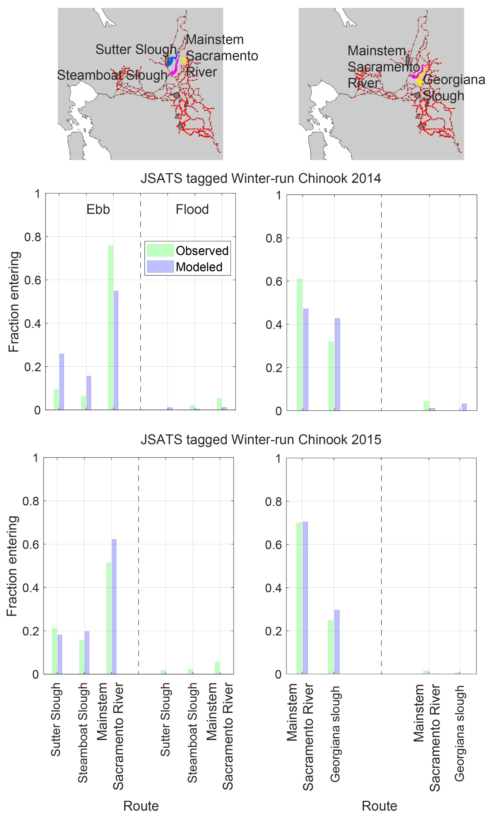
Validation results: Routing
Notes:
Ok, so, here we’re going to be looking at fractions of fish using different routes during different phases of the tide at two key junctions. I want to stress that routing is not an aspect of the model we have calibrated for. In fact, the routing component of the model does not even have any calibration parameters. The two maps show the two sets of junctions we looked at, and the key migration routes along them. The colored arrows are just to guide your eyes.

Slide 26
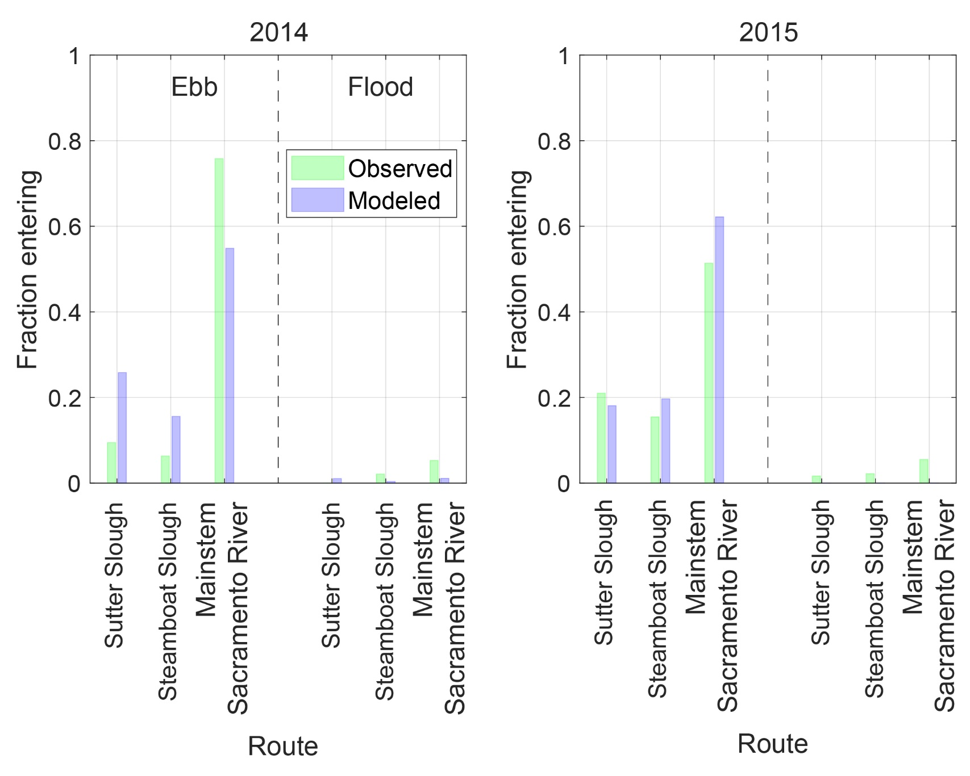
Validation results: Routing and Sutter and Steamboat
Notes:
Here, green bars indicate fraction of total Chinook passing through telemetry stations in the different routes. Blue bars indicate ePTM predictions of fraction of particles passing through equivalent nodes on the DSM2 grid. Passage fractions are aggregated over different phases of the tide. Here, the left panel corresponds to 2014 and the right panel is for 2015. Within the panels, the number of fish passing aggregated over all ebb phases are shown on the left, and similarly for all the flood phases on the right.
We can see two things: First, routing probabilities are captured by the model to within 0.1 of the observed routing.
Second, the patterns in routing through the junction, that is with far more fish going through the Mainstem Sacramento in both years are qualitatively seen in the model as well.

Slide 27
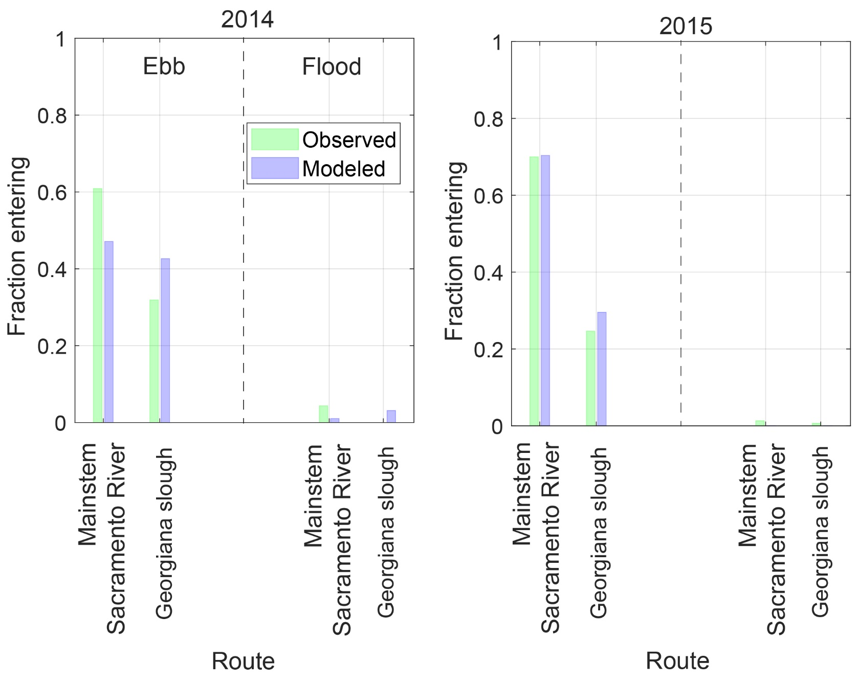
Validation results: Routing at Georgiana Slough
Notes:
The same layout as before for the junction of Georgiana Slough with the Mainstem Sacramento River. Here, too, we see that routing probabilities are captured by the model to within 0.1 of the observed routing. And that the pattern in routing through the junction, that is with more fish going through the Mainstem Sacramento, in both years is qualitatively seen in the model as well. The quantitative agreement in 2014 is not that great, and this is probably because we applied the particle filter in a very approximate way and it was on for the entire simulation period. I suspect that if we had applied the filter coinciding with the floating fish guidance structure placement windows correctly, we’d have gotten even better agreement. This is truly remarkable!

Slide 28
Questions
Notes:
With that, I’ll close. Questions?

Slide 29
Supplementary material

Slide 30
Data analysis
Notes:
Ok, great. So we have a model that’s biologically realistic and consistent across scales, and that’s been calibrated and performs well out-of-sample.

Slide 31
Salmonid behaviors in the Delta
Consultation with stakeholders
Literature review
Analysis of the acoustic telemetry data
Some patterns are exhibited by all salmonids and all runs of Chinook
Mechanism of migration is consistent between local- and system-scales
Evidence is based on work reported in
Sridharan and Hein 2019: Water Resources Research
Sridharan 2020: ASCE Watershed Management Conference Proceedings
Olivetti et al. 2021: Methods in Ecology and Evolution
Additional analysis: Sridharan et al.; Sridharan et al.; Gil et al.; Burford et al.
Allows us to calibrate and validate the model with different runs of Chinook
Notes:
I’ve said numerous times before, that to understand salmon behaviors from the ground up, we’ve used a variety of approaches.
We’ve engaged with you all, and done a thorough literature review. We’ve also analyzed acoustic telemetry datasets collected using VEMCO and JSATS tags, and found that all the salmonids we looked at seem to be doing similar things fundamentally, but maybe varying in intensity. Through the CDFW Prop 1 grant, we’ve been looking at 2D acoustic tracking datasets for Chinook and Steelhead at the Head of Old River and Georgiana Slough in conjunction with ADCP data and a CFD model we built, and the conventional acoustic telemetry data to figure out the mechanism of migration that is consistent across fine-scales of motion and macroscopic system-scales. A lot of this work has been reported in three papers already, and we have a few papers in various stages of completion that will allow us to paint a reasonably complete picture of salmonid migration.
What all of this does, is allows us to calibrate and validate the model using most of the available data. I’m going to talk briefly about some interesting patterns in the 1D datasets we’ve looked at that we can leverage during the calibration and validation. The point of the next few slides is to show that we can indeed use different runs of Chinook to calibrate and validate the model.

Slide 32
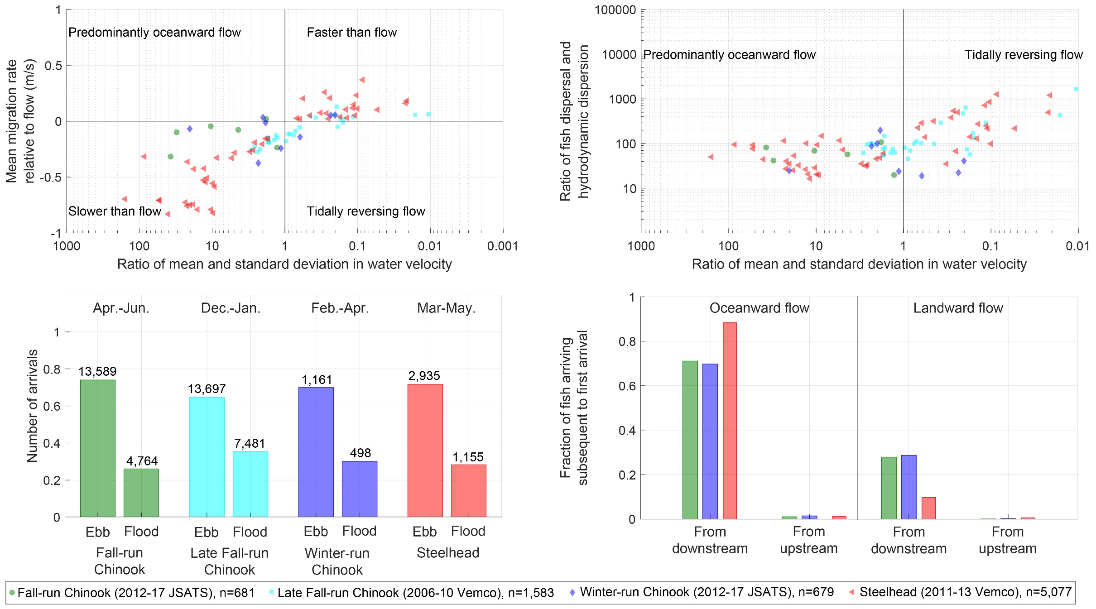
Salmonid behaviors in the Delta (cont…)
Notes:
Here, I’m showing mean migration rate through different reaches in the Delta as a function of flow conditions. In this and the next few plots, green is for fall-run Chinook, cyan is for late Fall, blue is for Winter-run and red is for steelhead.
The x axis shows how strong unidirectional oceanward flow in the reach is divided by the RMS in fluctuations about the mean flow, and goes from strongly oceanward flows on the left to strongly tidally reversing flows on the right.
The vertical line at 1 demarcates where the flow starts to reverse with respect to this scale.
The y axis shows the difference in mean migration rate through the reaches for different release groups and the mean flow during the period the fish occupied those reaches.
Values lower than 0 indicate fish generally moving slower than flow: this might be achieved by swimming along river banks, or by positive rheotaxis. Values greater than 1 indicate fish moving generally faster than flow. The horizontal line indicates where fish transition from going slower than the flow generally to going faster than the flow.
We clearly see that across all runs of Chinook, and even across multiple salmonids, the migration rate increases as fish get closer to the ocean.

Slide 33
Salmonid behaviors in the Delta (cont…)
Notes:
Now, I’m comparing how much dispersal there is in these fish groups as hey move through the system. The x axis is the same as before, but the y axis shows a number that is proportional to the harmonic mean of arrival times and measures the spread in fish arriving at telemetry stations. Fish across the board seem to be dispersing more as they get closer to the ocean. This happens both because of the tides, but also because of different behaviors adopted by fish during different phases of the tides.

Slide 34
Salmonid behaviors in the Delta (cont…)
Notes:
Here, I’m showing bar plots for the four different salmonids considered of total detection events during the ebb or oceanward phase of the tide, and the flood or landward phase of the tide aggregated over all the tidal stations in each study. The month ranges on top are when the releases happened, and the numbers above each bar indicate the total number of detections. The point of this plot is to show that no matter what the run or species or time of year, more fish typically arrive during the ebb tide than during the flood tide. This is not just because of the tides, because if it were, then there should have been a more or less even split in arrivals.

Slide 35
Salmonid behaviors in the Delta (cont…)
Notes:
Here, I’m showing the same data, but plotted now looking at the precedents of those detections. On the left side of this plot are bars showing detections at all tidal stations that happened during the ebb tide, and on the right are bar plots of detections that happened during the flood tide. These are further broken down by where the fish that was detected, was detected prior to this focal detection event. We see that again across runs and species, there is a strong bias to migrate towards the ocean, and likely hold against the flow when the tide reverses. There is in fact some evidence for this from the 2D tracking studies as well.

Slide 36
Salmonid behaviors in the Delta (cont…)
Notes:
Ok, so the point of all of this was that, no matter the species of salmonid, they all pretty much do the same thing to varying degrees. So, we feel reasonably justified in calibrating the model with one set of data and validating it with quite another set altogether.

Slide 37
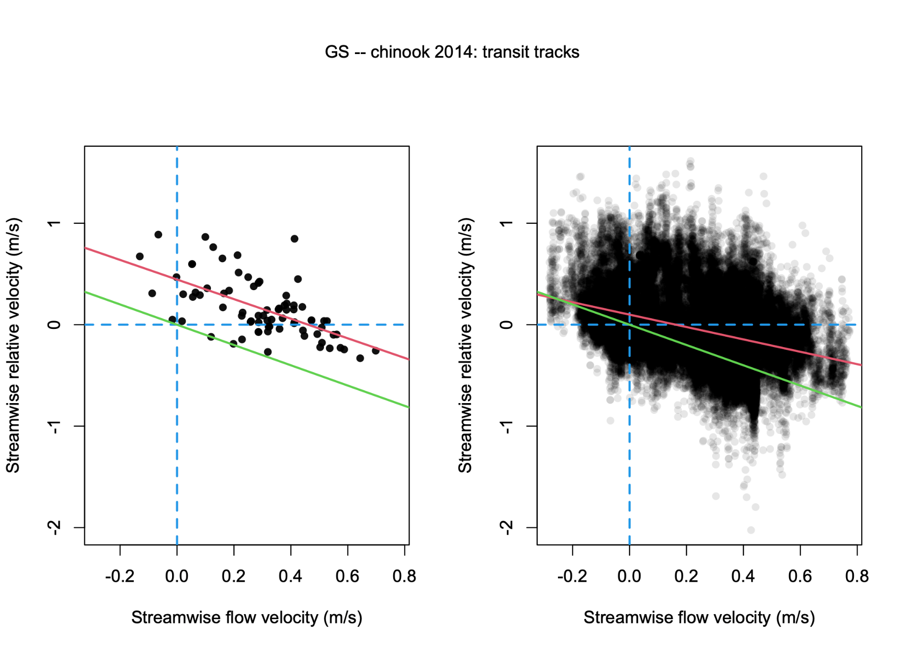
Mechanism of oceanward migration
Notes:
Looking at the 2D fish tracks at Georgiana Slough reveals how fish migrate oceanward. Here, we’re showing the relative movement rate of fish to the water flow. The left side is showing the mean migration rates over decorrelation timescales. The right side is for instantaneous movement rates. Green line is the relative velocity fish would have to exercise to fully nullify the flow, and red line is the actual relationship between flow and fish relative movement rates. The blue cross indicates flood-ebb demarcation and fish swimming slower than or faster than the flow. It’s clear from the plot on the left that as the red line is always higher than the green one, fish resist the flow during the flood, and go with the flow during the ebb. But even while going with the flow during the ebb, they slow down relative to the flow at higher flows.
On the right, we see that the fish progress towards the ocean faster, and actively resist the flow during the flood. They thus execute selective tidal streaming for sure.

Slide 38
Parameter spatial patterns
Notes:
Ok, great. So we have a model that’s biologically realistic and consistent across scales, and that’s been calibrated and performs well out-of-sample.

Slide 39
Patterns in the parameters’ values
Notes:
Ok, so we got a model that seems to be doing very well in-sample. But in a spatially explicit model like this with 99 tunable parameters, we’d like to be sure that the model is not just overfitting and that the parameter values actually make sense. First of all, we selected biologically plausible bounds for all of these parameters from a synthesis of the literature, and saw that the fitting process is not resulting in optima that nudge these prior bounds. Next, we analyzed the spatial patterns in these parameters to convince ourselves that the model is indeed doing what it is supposed to be doing, and not just fitting to noise in the data.
In what follows, I’ll be showing a series of graphs for each model parameter which represent reaches of the delta, colored by the parameter’s value. Warm colors indicate large parameter values, and cool colors indicate small parameter values.

Slide 40
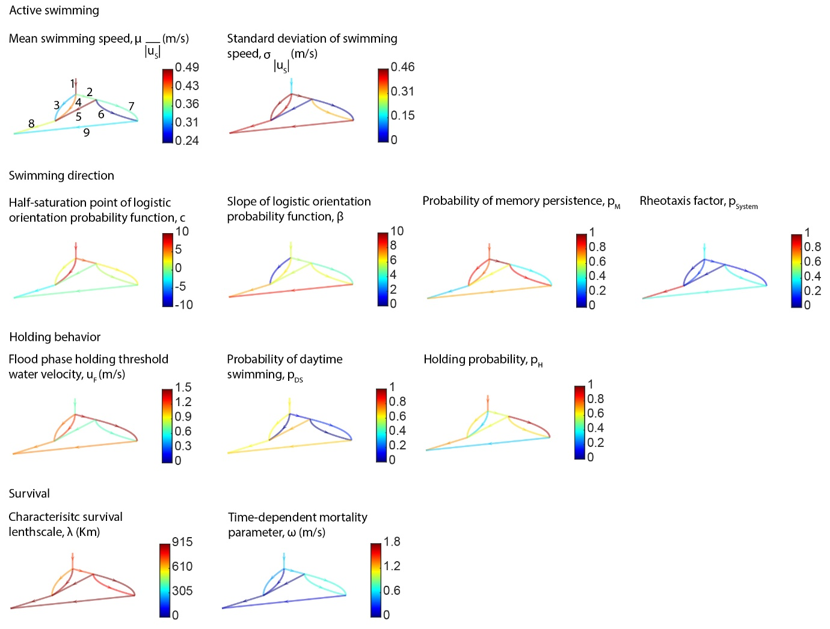
Patterns in the movement parameters’ values
movement rate
movement
rate
Notes:
For the movement component of the model, large values of the mean movement rate, $\overline{\left|u_{S}\right|}$, combined with small values of the probability of rheotaxis, $p_{System}$, and a strong probability of memory persistence, $p_{M}$, in the North Delta reaches result in fish actively swimming against strong riverine flows. In the more tidally reversing Central, South and Western Delta regions, decreasing mean migration rate, probabilities of rheotaxis, typically exceeding 0.5 and reduced memory persistence result in fish executing either movements that are directed weakly with or against the flow. The standard deviation in migration rates, $σ_{\left|u_{S}\right|}^{2}$, generally increases through the Delta. Together, these parameters result in actions by the fish that increase migration rate and increasing dispersion with increasing proximity to the ocean, as we observed in the acoustic telemetry datasets.

Slide 41
Patterns in the orientation parameters’ values
Notes:
The orientation and holding parameters allow simulated fish to move without losing ground continuously oceanward (or what we’ve called selective tidal stream transport in the past) in a way we observed in the 2D acoustic tracking studies. The trends in the half-saturation point, $c$, and slope, $β$, of the logistic orientation probability function are both decreasing from the upstream end to the downstream end of the Delta. In the nonreversing flow reaches with strong oceanward flows, the net effect of these parameters in combination with the small values of $p_{System}$ is to orient fish against the flow much more often than against the flow. In the tidal regions, these parameters allow the logistic response to be small when flows are weak, and thereby result in fish orientations that may switch between with and against the flow. When flows are directly strongly oceanward, the combination of these parameters and $p_{System}$ allows fish to be oriented more often with the flow.

Slide 42
Patterns in the holding parameter’ values
Notes:
During strongly landward flow reversals, the threshold holding velocity, $u_{F}$, and values of the holding probability, $p_{H}>0.5$, result in fish approximately maintaining position. The probability of swimming during the day, $p_{DS}$, is around 0.5, with no appreciable trend through the system, which is consistent with the values of around 0.34 to 0.75 obtained in this region from acoustic telemetry experiments by Chapman et al. (2013)

Slide 43
Patterns in the survival parameter’ values
Mean free path length between predator encounters, λ (Km)
Random closing speed, ω (m/s)
Notes:
The mean free path length between predator encounters generally increases downstream through the system, while the random closing speed generally decreases. This results in an overall increasing likelihood of survival through the downstream reaches of the system. This spatial pattern is consistent with what NMFS researchers, Cyril Michel, Nick Demetras and others have found about predator assemblages and predation event recorders in the Delta.

Slide 44
Sensitivity analysis
Notes:
Ok, great. So we have a model that’s biologically realistic and consistent across scales, and that’s been calibrated and performs well out-of-sample.

Slide 45
Elementary effects analysis
Morris method of elementary effects analysis applied to a simplified version of ePTM model domain with the same behavior suite.
An efficient algorithm to study parameter interactions for high-dimensional models. It starts at a random design point of model parameters and cycles through design points by perturbing the value of each parameter a set number of times while holding the values of the other parameters fixed, until all the parameter values are perturbed for the set number of times.
The Morris method allows us to simultaneously evaluate the importance of each parameter and its two-way interaction with every other parameter as follows. If the mean of the gradient in the goodness-of-fit measure with respect to a parameter (called the elementary effect) over all the trajectories is small, then this parameter is unimportant on its own. If it is large, then it is important on its own. If the standard deviation in the elementary effect over all the trajectories is small, i.e., the gradient with respect to this parameter does not change by much when the other parameters change, then this parameter does not interact with other parameters. If the standard deviation in the elementary effect over all the trajectories is large, then this parameter likely interacts with other parameters.
For 33 parameters in a 3-reach PTM, we began at a 100 randomly chosen parameter value sets within the bounds described above and simulated 3,400 toy PTM model runs. In each run, ten fish were release every two hours over 13 days for a total of 1,560 fish and the simulation was carried out for three months.
To evaluate the travel time distributions through the reaches, we used the Kullbeck-Leibler (KL) divergence between the observed and modeled travel times in each reach.
To evaluate the survivals through the reaches, we used the absolute difference between modeled and CJS-predicted survivals.

Slide 46
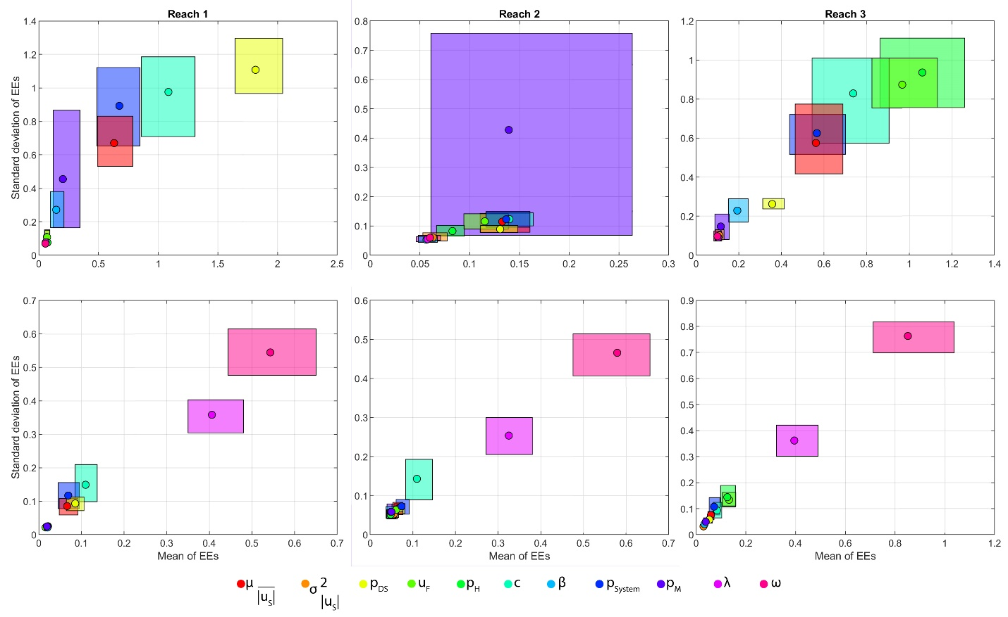
Elementary effects analysis
Notes:
In all the regions, the modeled survivals are primarily sensitive only to the survival parameters.
In the nonreversing reaches upstream of Georgiana Slough (top left panel corresponding to reach 1 in the coarse ePTM), the modeled travel times are likely most sensitive to the probability of daytime swimming, $p_{DS}$, the half-saturation point of the logistic orientation probability function, $c$, the probability of rheotaxis, $p_{System}$, and the mean migration rate, $\overline{\left|u_{S}\right|}$ (the parameters with the strongest elementary effects). The model is relatively insensitive to the slope of the logistic function, $β$, and standard deviation in migration rate, $σ_{\left|u_{S}\right|}^{2}$, here owing to the strong oceanward currents and low observed spread of fish in this region.
In Georgiana Slough, the Delta Cross Channel and in the interior Delta (top middle panel in corresponding to reach 2 in the coarse ePTM), we observe that the probability of memory persistence, $p_{M}$, $p_{System}$, $p_{DS}$, $\overline{\left|u_{S}\right|}$, $σ_{\left|u_{S}\right|}^{2}$ and $β$ contribute significantly to the sensitivity of the travel time simulation. This is because of the tidal nature of the flows in this region. The sensitivity to $β$ in this region indicates that the shape of the logistic function, which dictates the rapidity of the response to changing flows is important here. Low values of $β$ will result in the probability of orienting with the flow responding sluggishly to changing flows, while large values will ensure a more rapid response.
In the Southwestern reaches of the Mainstem Sacramento River (top right panel corresponding to reach 3 in the coarse ePTM), the travel time simulations are most sensitive to the holding threshold water velocity, $u_{F}$, probability of holding, $p_{H}$, $c$, $\overline{\left|u_{S}\right|}$ and $p_{System}$. In this region, the dispersion of fish in the acoustic tagging data is large, and therefore the model is insensitive to values of $σ_{\left|u_{S}\right|}^{2}$. However, as the flow strongly reverses here, fish behaviors will be highly sensitive to assumptions about the holding and rheotaxis mechanisms and these parameters will determine whether the model is able to recover the observed tidal ratcheting.
The expectation of a well-constructed mechanistic model is that any sensitivity analysis should reveal parameter dependencies that will functionally change behavioral responses depending on the nature of the causal relationships hypothesized by the values of the most important parameters in the model. In a spatially explicit model such as the ePTM, the relative importance of parameters can vary spatially as the mechanisms underlying the physical movement of fish changes. The sensitivity analysis done using the coarse ePTM is able to qualitatively confirm that the model is able to represent the hypothesized mechanisms of fish movements.

